Slide 1

Overtime Online Approval
Time & Attendance System
System Demo Presentation
Prepared by:
Ervin Olinas Brosas
ICT Department

Slide 2
Agenda:
Introduction to Overtime Online Approval System
Key Features
Current Workflow Setup
Cost Centers List
System Demonstration

Slide 3
Introduction:
The Overtime Online Approval System is:
  Paperless online approval of an employee’s overtime
  Has built-in workflow that handles the approval process and sending of system notifications to approvers
  Provides centralized and real-time data
  Web based
  In-house developed – no additional license cost

Slide 4
Key Features:
  Allows multiple submission of overtime requests as well as approval of assigned overtime requisitions in one go.
  Keeps track of all approval and workflow transactions and notifies all persons who have approved the request whenever it’s been rejected or modified by HR.
  Authorized users can search for overtime requisitions and data can be filtered by employee no., cost center, current assignee, creator, status, and date period.
  Automatic reassignment to the substitute in case the approver is on-leave or business trip.
  Access to the system is controlled and given only to authorized users.
  Integrated with other GARMCO systems such as JDE and Access system.

Slide 5
Current Workflow Setup:
  Production:
    Head of Department / Shift Supervisor
    Department Manager
    Senior Production Manager
    GM Operations
    HR Validator
    Head of HR
  Engineering (Electrical, Mechanical, Utility & Roll Grinding):
    Head of Department / Shift Supervisor
    Department Manager
    Senior Engineering Manager
    GM Operations
    HR Validator
    Head of HR
  QC & Lab:
    Head of Department / Shift Supervisor
    Department Manager
    Senior QC Manager
    GM Operations
    HR Validator
    Head of HR

Slide 6
Current Workflow Setup:
  Security:
    Direct Supervisor
    Department Manager
    Senior HR & Admin. Manager
    HR Validator
    Head of HR
  Medical:
    Department Manager
    Senior HR & Admin. Manager
    HR Validator
    Head of HR
  Safety:
    Head of Department
    Senior HR & Admin. Manager
    HR Validator
    Head of HR
  Stores:
    Head of Department
    Department Manager
    HR Validator
    Head of HR

Slide 7
OT Enabled Cost Centers:
Cost Center | Cost Center Name | Company Code | Group Code
2110 | REMELTMELTINGCASTING | 00100 | PRD
2111 | GREENFIELD REMELT EXPANSION | 00100 | PRD
2112 | EMP | 00100 | PRD
3220 | SCALPING | 00100 | PRD
3230 | PREHEATSLABHEATINGFURNACE | 00100 | PRD
3240 | HOTMILL | 00100 | PRD
3250 | ROLLGRINDING | 00100 | PRD
3310 | ANNEALINGCOOLINGBOOTHS | 00100 | PRD
3320 | COLDMILL1 | 00100 | PRD
3322 | COLDMILL2 | 00100 | PRD
3410 | TENSION LEVELLER 1 | 00100 | PRD
3412 | TENSIONLEVELLER2 | 00100 | PRD
3415 | TENSION LEVELLER 3 | 00100 | PRD
3420 | SLITEMBOSS | 00100 | PRD
3430 | CTLRFGUIL | 00100 | PRD
3470 | PACKINGINCLCARPENTRY | 00100 | PRD
3800 | GENERALFACTORY | 00100 | PRD
4100 | QUALITYCONTROLWORKS | 00100 | QC
4200 | LABORATORY | 00100 | QC
5200 | MECHANICALENGINEERING | 00100 | ENG
5300 | ELECTRICALENGINEERING | 00100 | ENG
7150 | ADMINISTRATION SERVICES | 00100 | S&M
7200 | SAFETYSECURITY | 00100 | ADM
7250 | MEDICALSERVICES | 00100 | ADM
7300 | STORES | 00100 | ADM

Slide 8
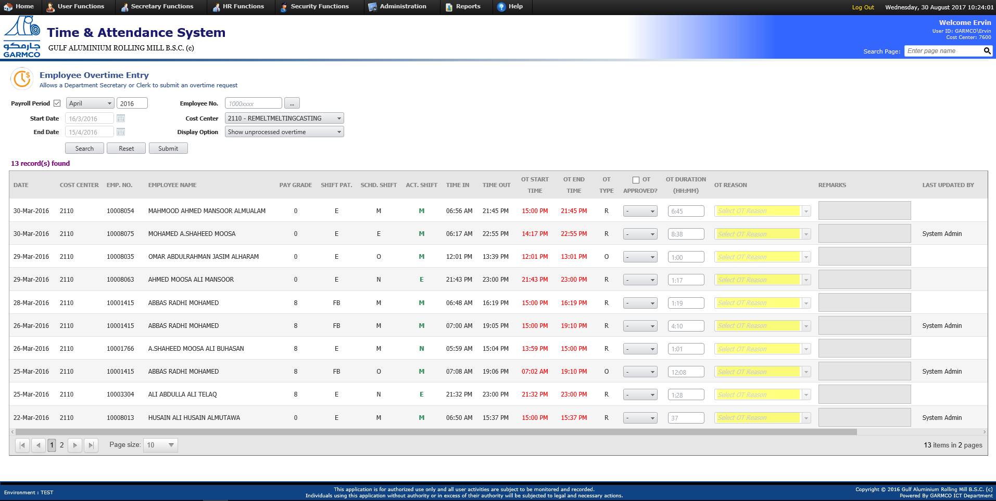
System Demo:

Slide 9
Thank You!

